Slide 1






DATA ANALYTICS PORTFOLIO SUMMARY
Josh Abrams
joshuarabrams@gmail.com
Github
Linkedin

Slide 2
Projects
o Rockbuster Stealth: Video Rentals
o GameCo: Video Game Sales
o CDC: Influenza Deaths
o Instacart: Sales
o Kings County Home Sales

Slide 3
ROCKBUSTER STEALTH Sales and customer demographic analysis for a video rental store looking to migrate to an online platform.
Dataset:
Movie rental statistics
Customer demographics
Film characteristics
Payment transactions
Tools Used:
PostgreSQL
Tableau
Skills Shown:
Writing Queries
Cleaning/Summarizing Data
Joining Tables
Writing Subqueries
Technical Documentation

Slide 4
PROJECT BRIEF
Background:
Rockbuster Stealth is a movie rental with stores around the world. With the recent increase in streaming popularity, they are looking to transitioning into an online movie rental platform. The goal of this analysis is to answer business and demographic questions to help shape their launch strategy.
Key Objectives:
o Are certain types of games more popular than others?
o What other publishers will likely be the main competitors in certain markets?
o Have any games decreased or increased in popularity over time?
o How have their sales figures varied between geographic regions over time?
Dataset:
Database with data tables including customer demographics, rental transactions, film inventory, film genre, film ratings, and employee data.

Slide 5
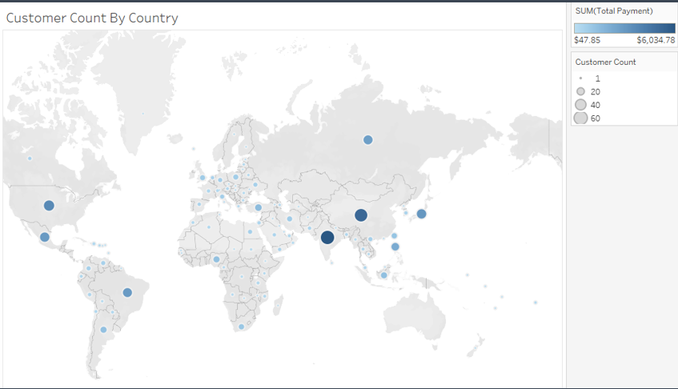
ANALYSIS Top Countries -Number of Customers and Revenue
Using PostgreSQL, I cleaned the data. Utilizing joins and subqueries, I found insights into customer locations and spending habits to help determine the top countries for Rockbuster to build its online platform. I then used Tableau to create visualizations and present the data.

Slide 6
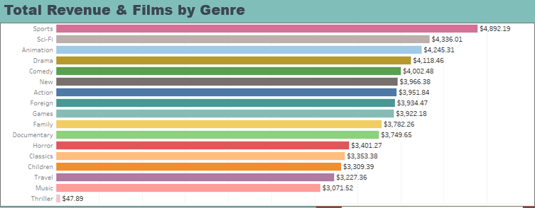
RESULTS
Recommendations:
o The largest markets for Rockbuster and the markets where Rockbuster should focus its initial rollout are India, China, United States, Japan, and Mexico.
o The most popular genres of movies are sports, sci-fi, animation, drama, and comedy. These films should be given priority when obtaining licensing agreements.

Slide 7
GAMECO: Descriptive analytics for a video game company to inform the development of future games.
Dataset:
VGChartz historical video game sales data from 1980 to 2016: https://www.vgchartz.com/
Tools Used:
Excel
Skills Shown:
Summarizing Data
Descriptive Analytics
Excel Visualizations

Slide 8
PROJECT BRIEF
Background:
GameCo is a video game company that sells video games globally. They have asked for descriptive analytics on historical sales in order to allocate money to new game development.
Key Objectives:
o Are certain types of games more popular than others?
o What other publishers will likely be the main competitors in certain markets?
o Have any games decreased or increased in popularity over time?
o How have their sales figures varied between geographic regions over time?
Dataset:
Dataset from VGChartz that covers historical sales of video games that have sold more than 100,000 copies worldwide. The data covers the years 1980 to 2016 and was pulled from the VGChartz website

Slide 9
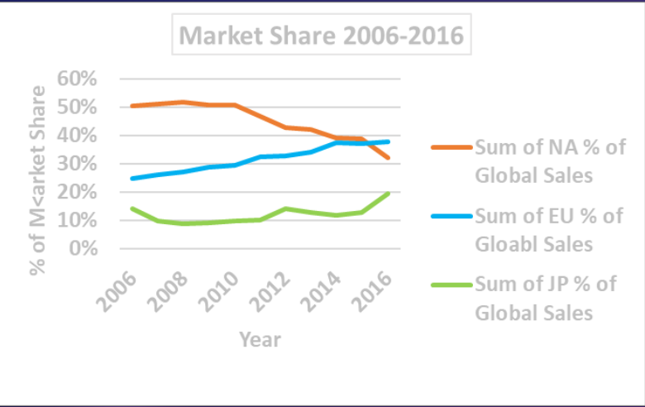
ANALYSIS
For this analysis, I grouped data by both region and console. I graphed the trends for the last 20 years for each market and compared how they changed over time.

Slide 10
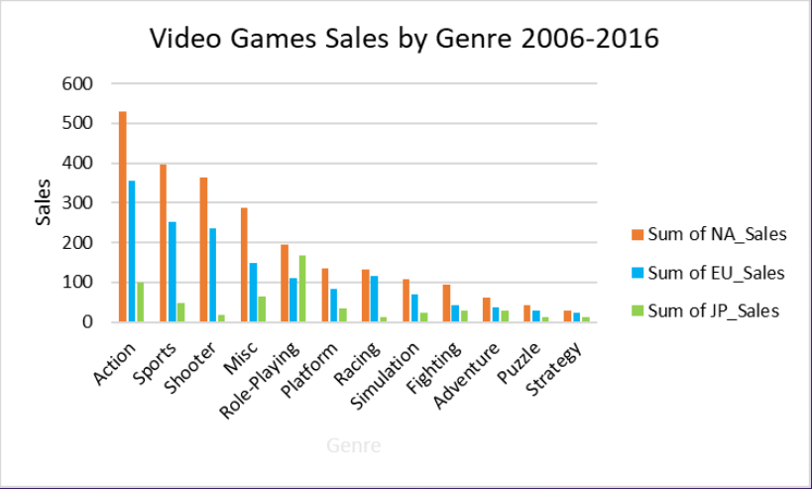
RESULTS
Recommendations:
o Reallocate marketing resources from the shrinking North American market to the growing European market
o Reallocate marketing resources to capitalize on the increasing popularity of games in the Sports genre
o Focus on sales of PlayStation and Xbox games as those consoles that make up over 80% of the market

Slide 11
CDC DATA: INFLUENZA DEATHS Predicting influenza deaths in the US by geographical region
Dataset:
CDC: Flu deaths by geography, time, age, and gender
Tools Used:
Excel
Tableau
Skills Shown:
Data Cleaning
Counts of flu lab test results by state
US Census Bureau: Population by geography
Data Integration
Data Transformation
Hypothesis Testing
Forecasting
Tableau Storyboards

Slide 12
PROJECT BRIEF
Background
o A medical staffing agency provides temporary workers to hospitals and medical facilities. The agency wants to look at trends in flu season data to plan for the upcoming flu season to better allocate personnel across the country.
Key Objective
o Determine when to send staff to each state to best combat the upcoming flu season.
Datasets
o The Center for Disease Control (CDC) website provided data for flu deaths by geography, time, age, and gender, as well as counts of influenza laboratory test results by state. o The US Census Bureau website provided US population data broken down by state.

Slide 13
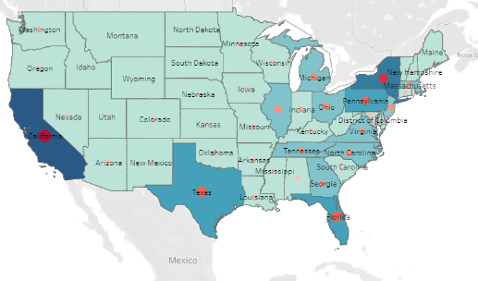
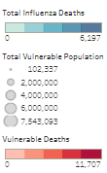
Analysis
Starting in Excel, I cleaned the data and merged multiple datasets before uploading to Tableau. In Tableau I searched for insights on vulnerable populations, high risk factors, and seasonality in flu related deaths.

Slide 14
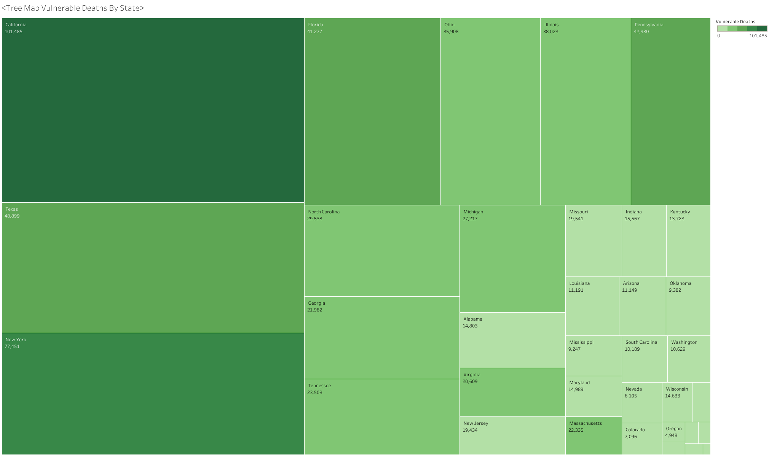
RESULTS
Recommendations
o The most at-risk population is the elderly. Focus excess personnel where elderly populations are highest, California, New York, Texas, Pennsylvania, and Florida
o Peak flu season, and therefore the highest staffing need, is November through March.

Slide 15
CDC DATA: INFLUENZA DEATHS Predicting influenza deaths in the US by geographical region
Dataset:
Orders
Tools Used:
Excel
Python
Skills Shown:
Data Wrangling
Products
Departments
Data Merging
Deriving Variables
Aggerating Data

Slide 16
PROJECT BRIEF
Background
Instacart is an online grocery platform that uses an app to let customers place orders. The company wants an exploratory analysis and recommendations for strategies that will sales based on a set of criteria.
Key Objective
o What are the business days of the week and hours of the day?
o Are there particular times of day when people spend the most money?
o How do products sell by price range?
o Are certain types of products more popular than others?
o What is the distribution of sales given factors such as brand loyalty, region, age, or family status.
Datasets
Public datasets for Instacart with data on products, order history by user, and departments.

Slide 17
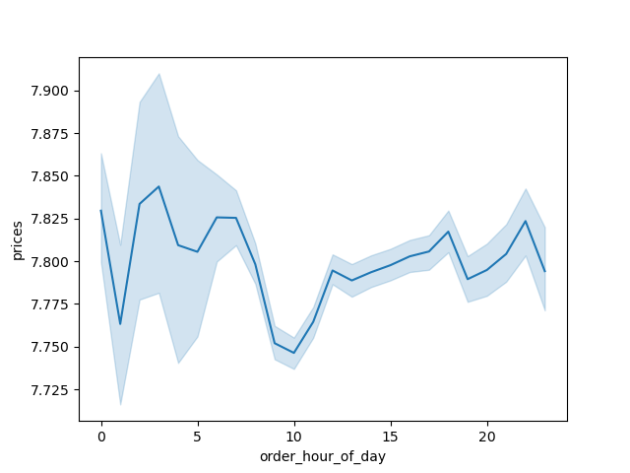
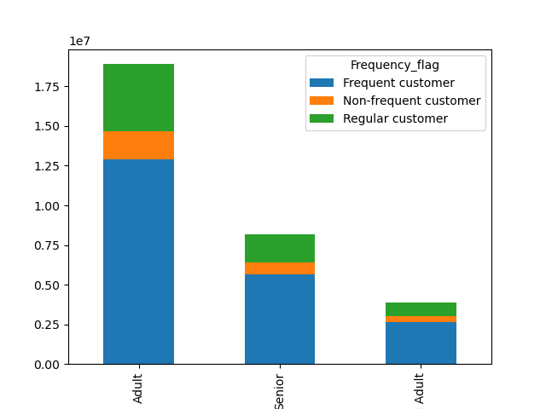
ANALYSIS
o Using Python, I imported and merged multiple datasets. After cleaning the data and deriving criteria variables, I derived insight about the number of orders on certain days, how criteria such as age effected purchasing habits, and what products were most popular.

Slide 18
RESULTS
Next steps would include targeting the clusters that are most attractive from a real estate investment perspective. Pricing Properties:
- Properties in highly populated areas are the more expensive.
- Highest square foot prices are in central Seattle and Bellevue (Bay Area).
- Properties out of town and in more rural areas are lower priced.
- Zipcode Areas south of Seattle have on average the lowest square foot price.
Data Limitations:
- The data on house sales is old data from 2014/2015. It is impossible to get any insight into
price development as it does not depict current trends.
Possible Next Steps:
- Gather current data on house sales to analyze price development.
- Investigate the impact of other house features on the real-estate price

Slide 19
Kings County Home Sales Sales and customer demographic analysis for a real estate company looking to invest in homes
This dataset contains house sale prices for King County, which includes Seattle. It includes homes sold between May 2014 and May 2015.
https://www.kaggle.com/datasets/harlfoxem/housesalesprediction?resource=download
Dataset:
Tools Used:
Excel
Python
Tableau
Skills Shown:
Python Cleaning
Python Visualization
Python Analytics
Linear Regression
Clustering
Mapping

Slide 20
PROJECT BRIEF
Background:
A real estate company is looking to buy homes in King County Washington. to people who are looking for accommodations in specific locals. They want to make the most of their investments by investing in the most lucrative areas of King County. In this analysis we will explore the geographical trends and look at a price prediction model that can allow hosts to have a better understanding of what income can be made from their property based on historical property data and demographics.
Key Objectives:
o Do certain size properties sell more than others?
o Does the year-built effect sale price?
o Where are the most and highest value homes being sold?
o Are there any correlations between attributes and sale price we are not recognizing?
Dataset:
This dataset contains house sale prices for King County, which includes Seattle. It includes homes sold between May 2014 and May 2015:
https://www.kaggle.com/datasets/harlfoxem/housesalesprediction?resource=download
Postal Zip Codes and Associated Cities: https://www.unitedstateszipcodes.org/

Slide 21
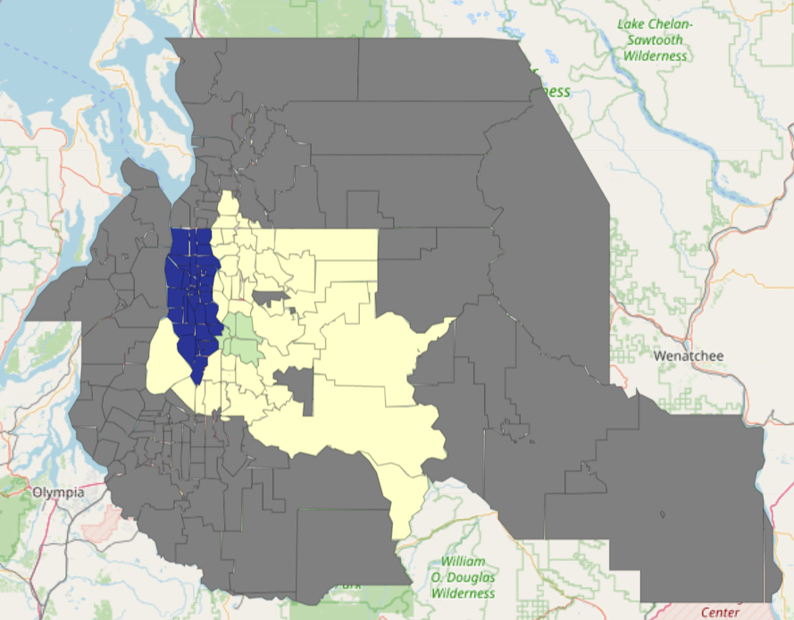
ANALYSIS Top Cities by Sales and Counts in Washington State
Using python, I cleaned the data. Utilizing derived variables and subqueries in order to better filter the data, I found insights into house locations and market pricing for the best real estate markets to invest in. I then used Tableau to create visualizations and present the data.

Slide 22
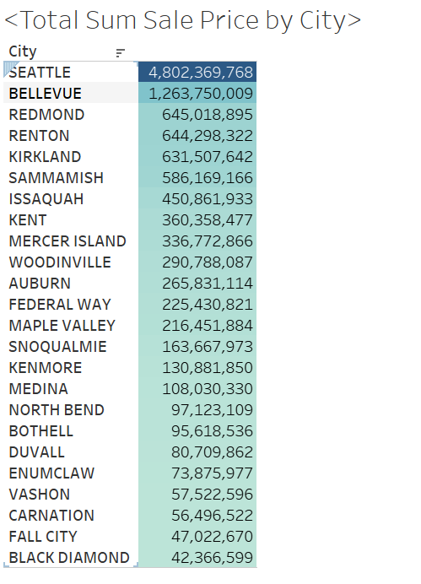
RESULTS
Recommendations:
o The largest and highest value markets for Washington state and the markets where we should invest Include: Seattle, Bellevue, Redmond, Renton and Kirkland.

Slide 23
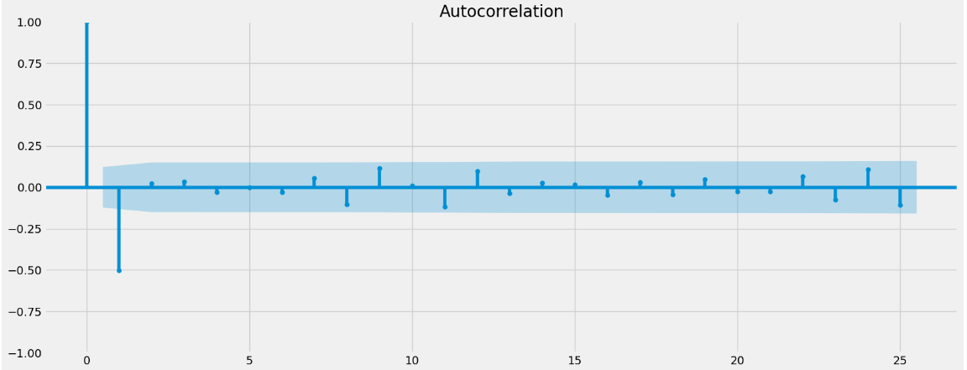
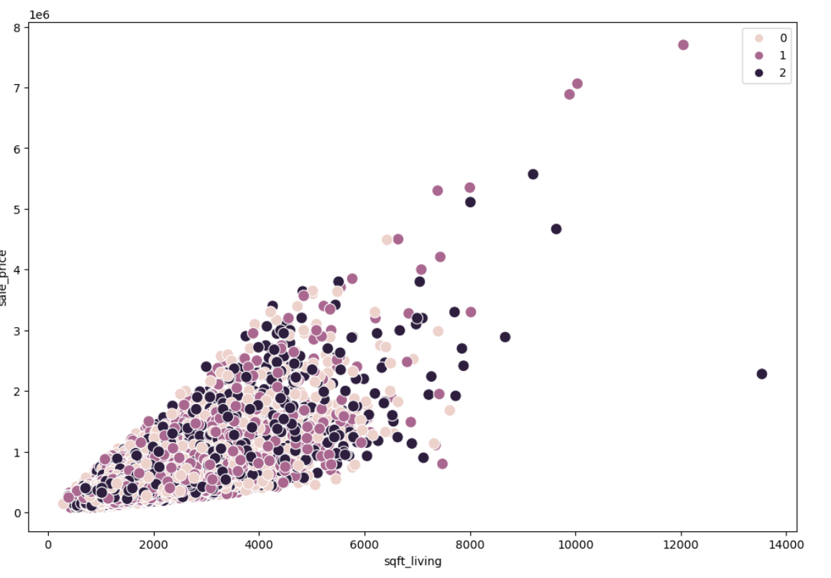
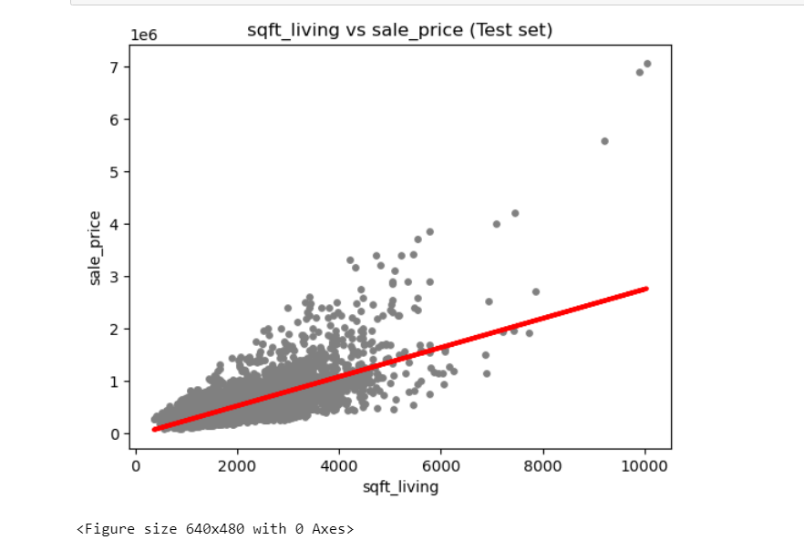
Regression and Cluster Analysis
Next steps would include targeting the clusters that are most attractive from a real estate investment perspective. Pricing Properties:
- Properties in highly populated areas are the more expensive.
- Highest square foot prices are in central Seattle and Bellevue (Bay Area).
- Properties out of town and in more rural areas are lower priced.
- Zipcode Areas south of Seattle have on average the lowest square foot price.
Data Limitations:
- The data on house sales is old data from 2014/2015. It is impossible to get any insight into
price development as it does not depict current trends.
Possible Next Steps:
- Gather current data on house sales to analyze price development.
- Investigate the impact of other house features on the real-estate price

Slide 24
THANK YOU
Josh Abrams
Joshuarabrams@gmail.com
LinkedIn | GitHub

